Slide 1

Which grocery bags are most sustainable?
Choosing Sustainability
National Sustainability Teachers’ Academy

Slide 2
What does
Sustainability
mean?
National Sustainability Teachers’ Academy

Slide 3
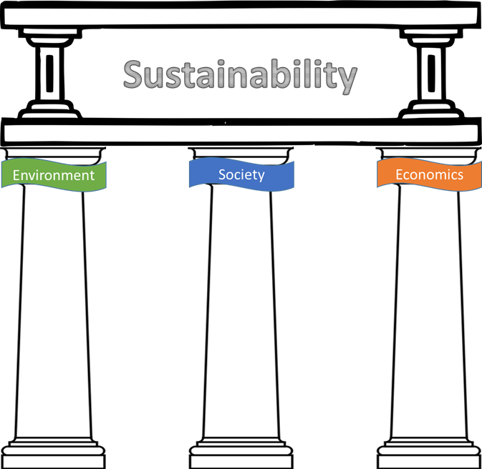
Sustainability rests on Three Pillars
Clean Air
Diversity
Jobs
Clean Water
Family
Fair Wages
Neighbors
Clean Soil
Trade
Wildlife
Health
Costs
National Sustainability Teachers’ Academy

Slide 4
How do we know if a product is
Sustainable?
National Sustainability Teachers’ Academy

Slide 5
A product is sustainable when it promotes all Three Pillars
Clean Air
Diversity
Jobs
Clean Water
Family
Fair Wages
Neighbors
Clean Soil
Trade
Health
Costs
Wildlife
National Sustainability Teachers’ Academy

Slide 6
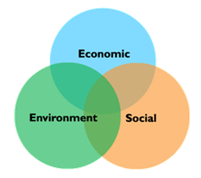
Sustainable solutions holistically encompass all three dimensions of sustainability
National Sustainability Teachers’ Academy

Slide 7
Sustainability Score
Economy
0
3
6
3
Environment
Low
0
3
6
High
0
Society
3
3
0
3
6
Sustainability Triangle Graph
National Sustainability Teachers’ Academy

Slide 8
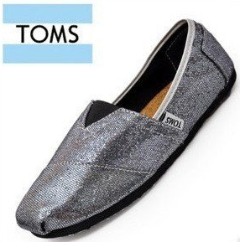
Sustainability Score
Economy
4
0
3
4
6
3
Environment
Low
0
2
3
6
High
0
Society
3
2
3
0
3
5
6
5
Sustainability Triangle Graph
National Sustainability Teachers’ Academy

Slide 9
Sustainability Score
Economy
0
3
4
6
3
Environment
Low
0
2
3
6
High
0
Society
3
3
0
3
5
6
Sustainability Triangle Graph
National Sustainability Teachers’ Academy

Slide 10
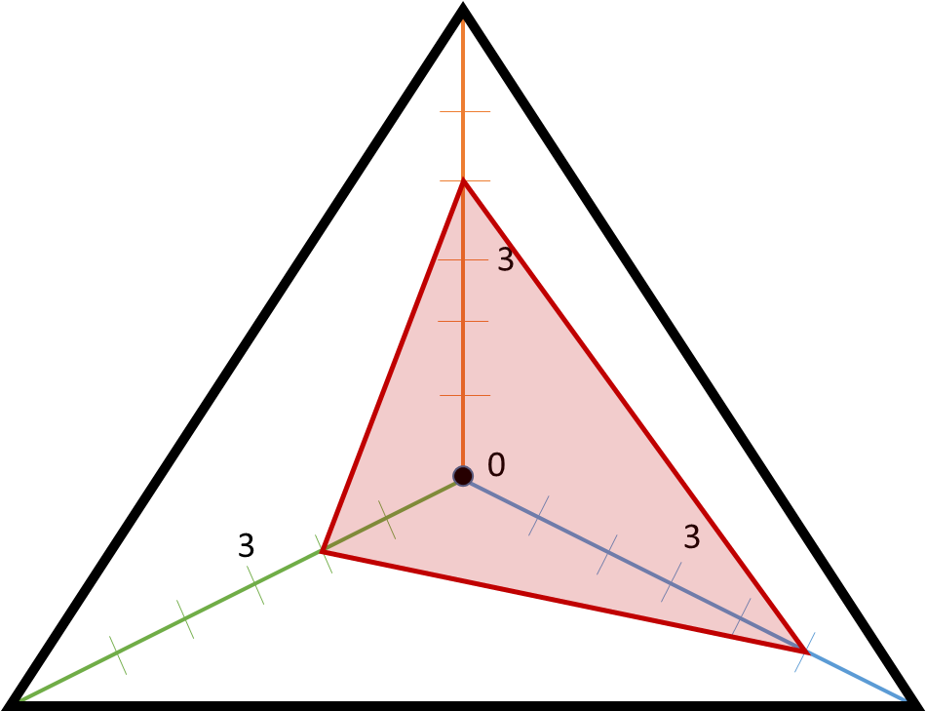
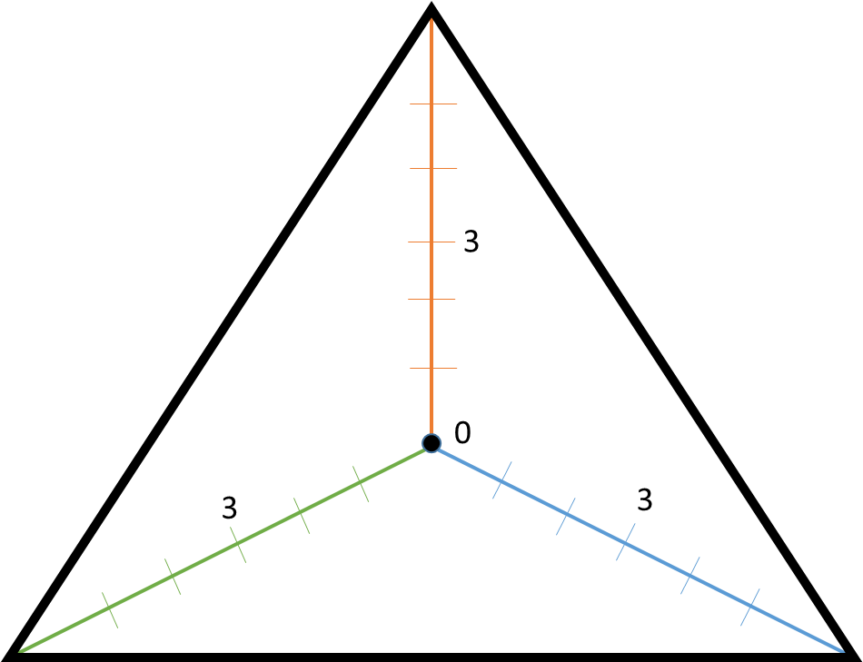
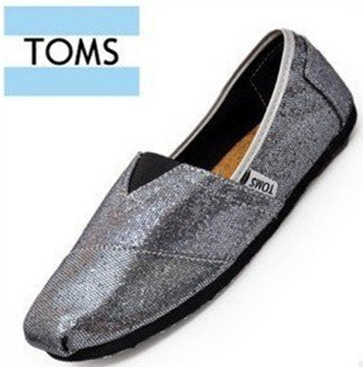
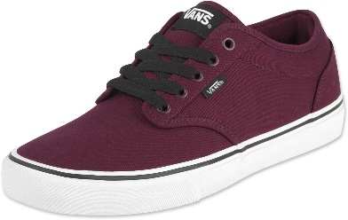
Which is more sustainable?
National Sustainability Teachers’ Academy

Slide 11
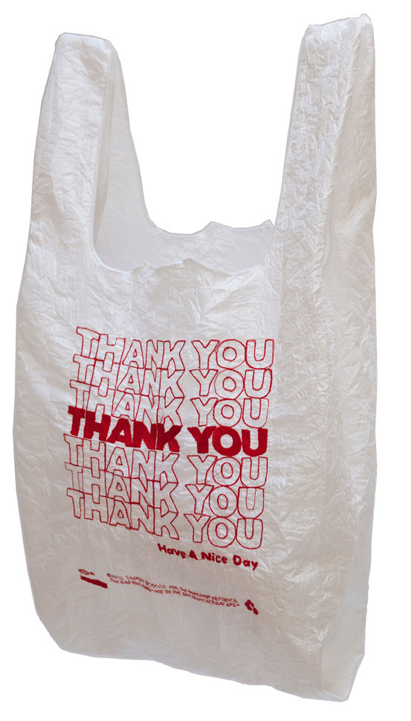

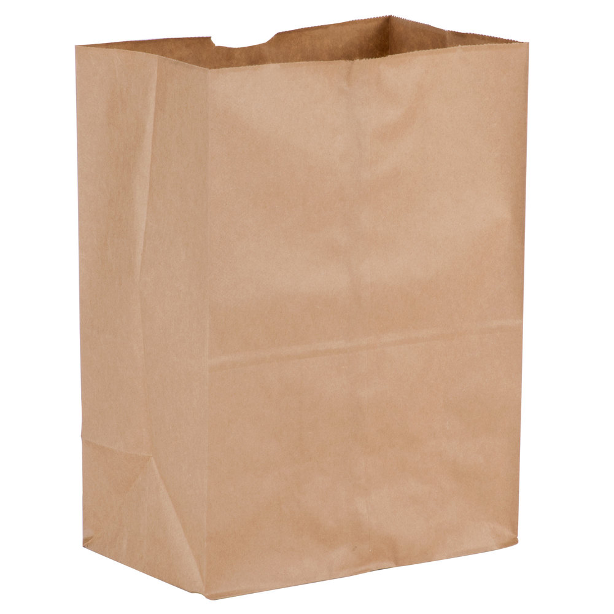
Which Grocery Bag is most
Sustainable?
National Sustainability Teachers’ Academy

Slide 12
Sustainability of Grocery Bags
A
B
C
National Sustainability Teachers’ Academy

Slide 13
Sustainability of Grocery Bags
National Sustainability Teachers’ Academy

